Slide 1

SMTI eMedic Card
Intern: Ng Ri Chi
Supervisor: Hang Kher Lee

Slide 2
What is done since the last update?
Modification of Medic and Profile data works
Adding new profiles
Changing parameters in profiles
Deleting profiles
Rudimentary User Management System

Slide 3
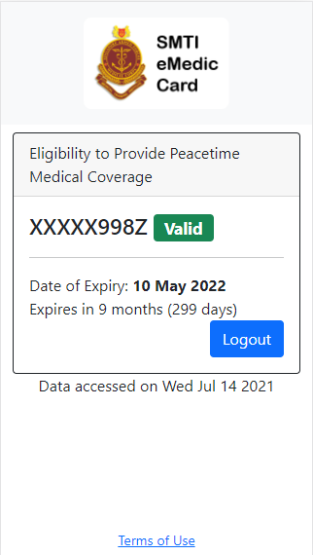
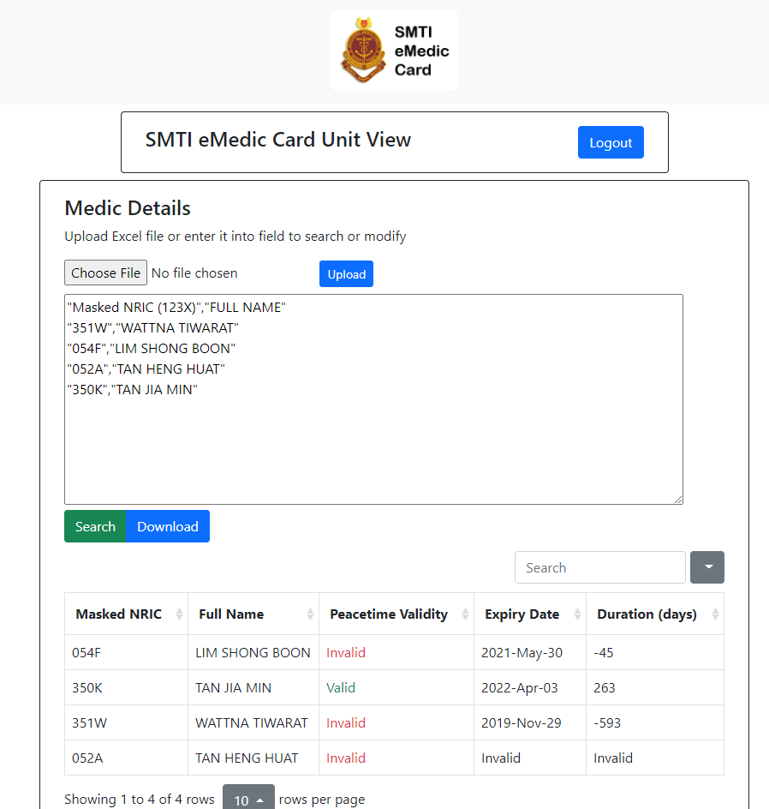
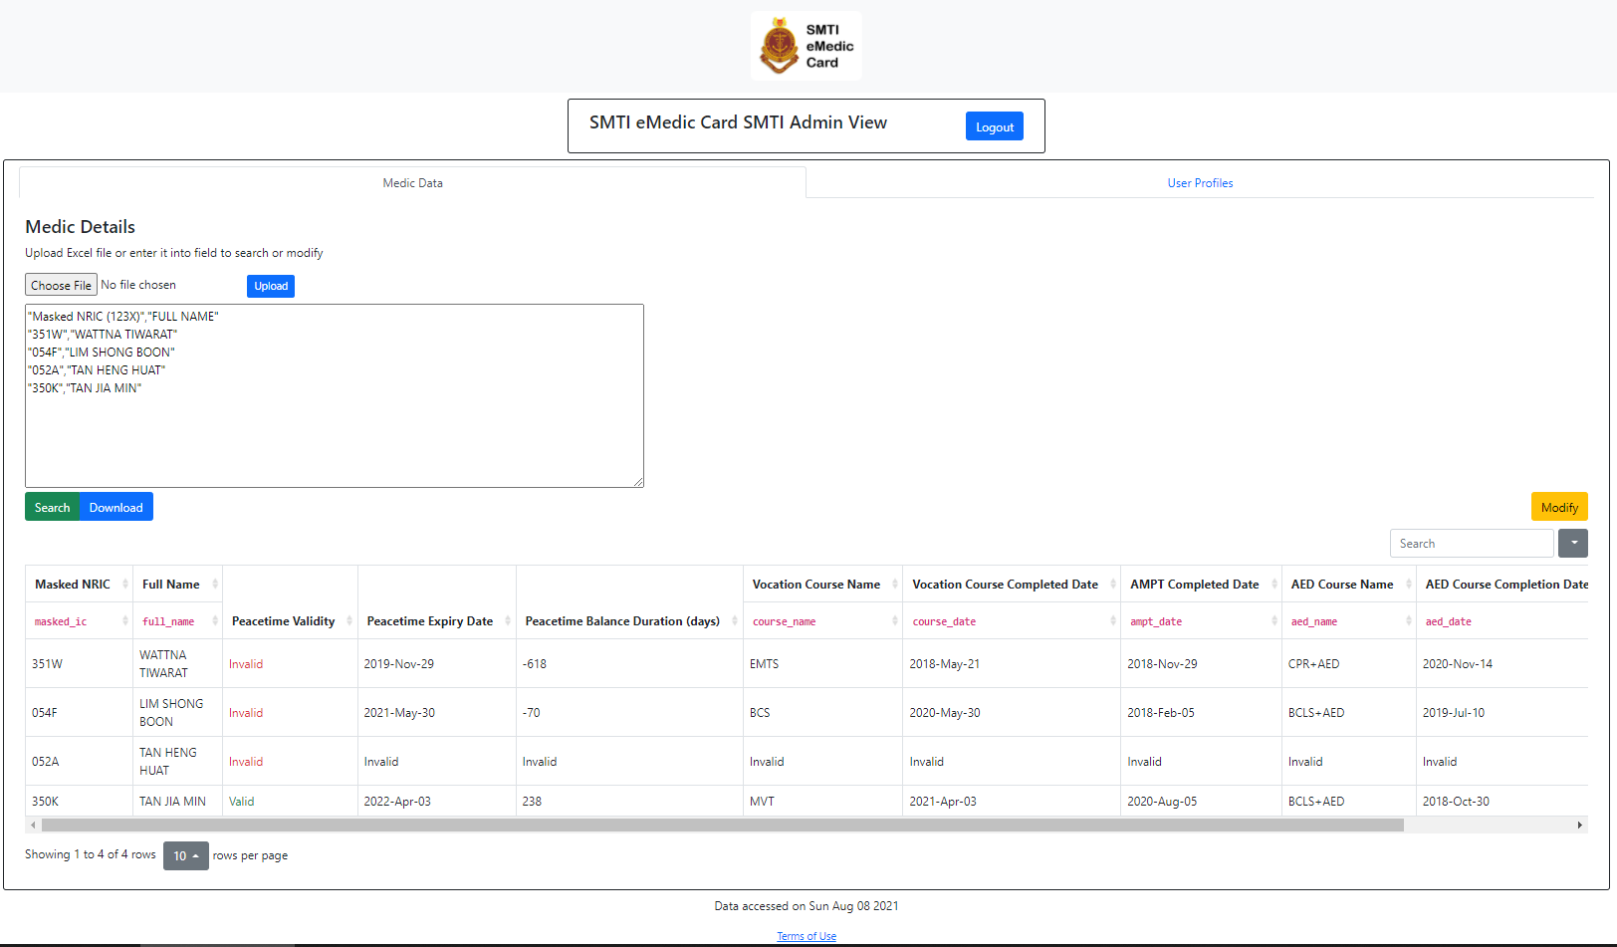
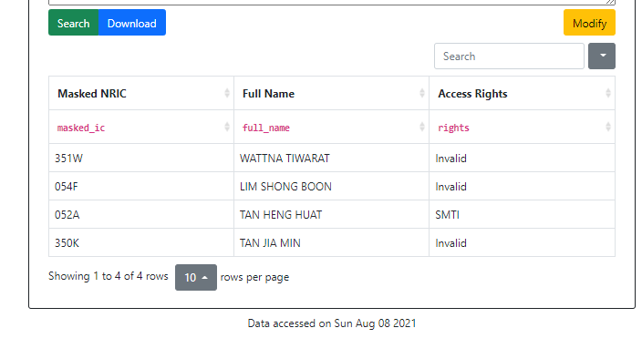
4 Types of views
Medic View
Unit View
SMTI View
Profile View

Slide 4
Access to views
All Medics
Unit Administrators
Medic View
Unit View
SMTI View
Profile View
SMTI Administrators

Slide 5
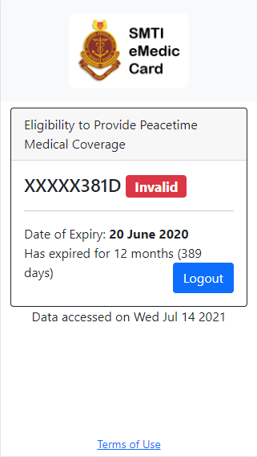
Medic View
Convenience for servicemen
Web app replaces physical card
Clearly states peacetime validity
Less wastage
No more yearly replacement

Slide 6
Unit View
Seamless administration
Check validity of multiple servicemen at once
Import query and export results in Excel files
LIVE DEMO!

Slide 7
SMTI View
Same as Unit View, but with more features
View more details
View AMPT and Vocational training completion dates
AED certificate and completion dates
Add, update and delete profiles
LIVE DEMO!

Slide 8
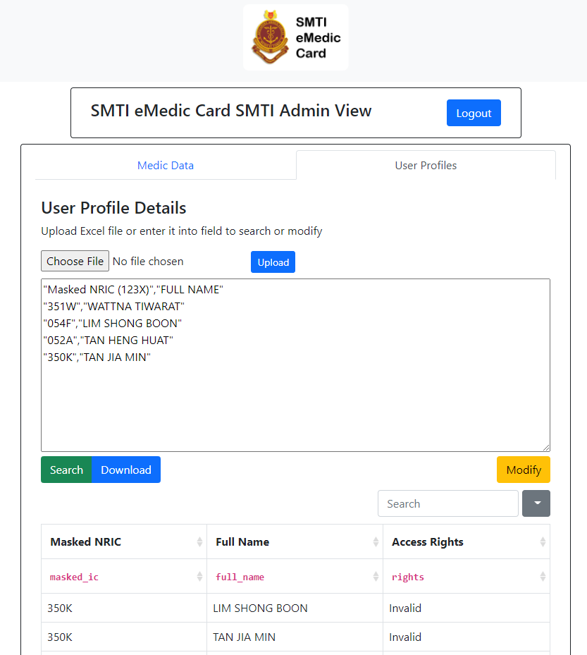
Profile View
View and edit who has access to Unit, Profile and SMTI view
LIVE DEMO!

Slide 9
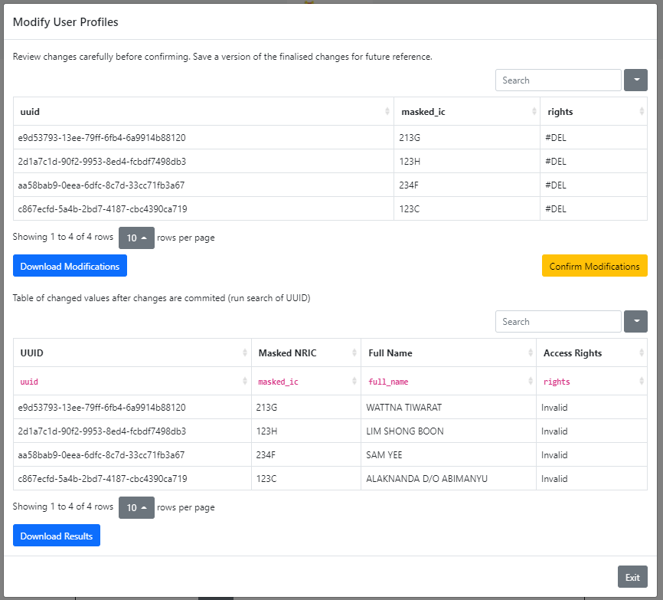
Process for modification
Upload Excel file/enter modification details
If no errors are found, modal with changes to be committed will be displayed
Check and confirm changes
Once changes are complete, table showing modified profiles will show
Download record of changes and final results for archive

Slide 10
Project Status
Completed | Interface/Basic Routing
Completed | Database Set Up and Profile generation
Completed | Querying feature for Medic, Unit, SMTI and Profile view
Completed | Modification feature for SMTI and Profile view
Completed | Simulated User Management
Completed | Documentation

Slide 11

Seeking Clearance
Security Management Plan (SMP)
Threat Risk Assessment (TRA)
Security Vulnerability Assessment (SVA)
⁂ Costs is involved for the above 2 assessments ⁂

Slide 12
Audience Time

